Slide 1
Grand Valley Bandwagon
Nicolas Heady, Michael Christensen, Ryan Korteway

Slide 2
Introduction
As a startup we chose to create a ride-sharing app for GVSU students. We wanted to encourage carpooling and alleviate some of the passenger congestions on the Rapid buses.
Many students have regular travel patterns between campuses to attend classes. We wanted to tap into this resource to provide students with a way to request rides from these drivers.

Slide 3
Features of GVBandwagon
Unique features to our app that reflect our community base, the student body.
Scheduled rides, with repetition - A ride to Downtown or to Allendale can be requested on a recurring basis (Mon. Wed. Fri.).
Plans are in place for maintaining a whitelist/blacklist for both riders and drivers - Your “favorites” will be identifiable from the crowd, and others can be completely ignored.

Slide 4
Project Information
The user interacts with the app in two key modes: as a rider or as a driver. Riders are able to ask for either immediate or scheduled/recurring rides and drivers can accept these requests.
With immediate rides, once a request is made and offers are accepted, the driver and rider can see each other on their respective maps. Their location is updated every 30 seconds through our Firebase backend.

Slide 5
Project Information Continued
Drivers can accepted scheduled and recurring rides as well. However, for these types of rides users communicate independent of the app to arrange meet up times and locations.
Additional functionality includes the use of Swift local notifications to inform users of changes such as ride request cancellations or ride offers being made while the app is closed.

Slide 6
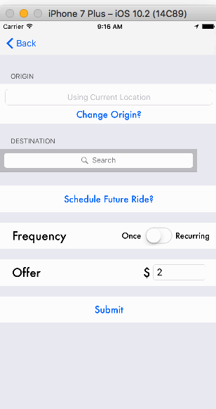
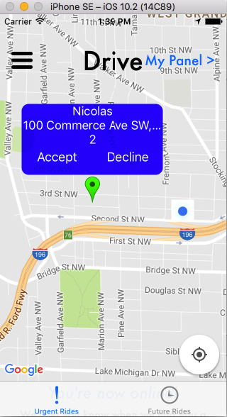
Sample Screenshots
On the left, a ride request is just starting to be created by Nicolas.
On the right side the request is being seen by a driver and they have the offer to accept the ride request or hit decline and make the pop up window disappear.

